Slide 1
Heat Effects
Heat effects refer to physical and chemical phenomena that are associated with heat transfer to or from a system or that result in temperature changes within a system, or both.
What happens when we heat water from room temperature to its boiling point?

Slide 2
Heat Effects
Ethylene glycol (a coolant and antifreeze) is made by catalytic partial oxidation of ethylene to form ethylene oxide, followed by a hydration reaction:
C₂H₄ + 1/2 O₂ → C₂H₄O
C₂H₄O + H₂O → C₂H₄(OH)₂
How many types of heat effects are involved?

Slide 3
Heat Effects
The following important heat effects would be considered
Sensible heat effects, characterized by temperature changes
Heat capacities as a function of temperature
Heats of phase transition, i.e., latent heats of pure substances
Heats of reaction, combustion, and formation

Slide 4
Heat Capacity
Heat Capacity of a system is defined is the amount of heat required to raise the temperature of the system through 1 degree Celsius (°C).
If ‘q’ is the amount of heat supplied to system and as a result, if the temperature of the system raises from T₁ and T₂, then the heat capacity of the system is given by:
C = q / (T₂-T₁)
C = q / ΔT

Slide 5


Molar heat capacity is the amount of heat energy required to raise the temperature of 1 mole of a substance through 1 (°C)
Specific heat capacity is the amount of heat energy required to raise the temperature of 1 kg of substance through 1 (°C)
There are two types of heat capacities
Heat capacity at constant volume (C_{v})
Heat capacity at constant pressure (C_{p})
Heat capacity at constant volume (C_{v}): the amount of heat required to raise the temperature of the system through 1 (°C) keeping the volume of the system constant
Integration yields:

Slide 6
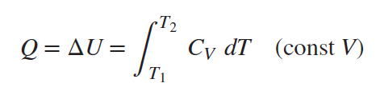




For a mechanically reversible, constant-volume process gives:
Heat capacity at constant pressure (C_{p}) : the amount of heat required to raise the temperature of the system through 1 (°C) keeping the pressure of the system constant
Integration yields:
For a mechanically reversible, constant-P process

Slide 7
Sensible Heat Effects
Heat transfer to or from a system in which there are no phase transitions, no chemical reactions, and no changes in composition causes a sensible heat effect, i.e., the temperature of the system is caused to change.
The need here is for a relation between the quantity of heat transferred and the resulting temperature change.

Slide 8

Sensible Heat Effects
When the system is a homogeneous substance of constant composition, the phase rule indicates that fixing the values of two intensive properties establishes its state.
The molar or specific internal energy of a substance may therefore be expressed as a function of two other state variables.
The key thermodynamic variable is temperature. With molar or specific volume chosen arbitrarily, we have U = U (T, V). Then

Slide 9

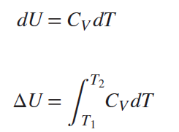
Sensible Heat Effects
The final term is zero in two circumstances:
For any closed-system constant-volume process.
Whenever the internal energy is independent of volume, as for the ideal-gas state and the incompressible liquid.
In either case,

Slide 10
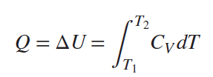
Sensible Heat Effects
The only possible mechanically reversible constant-volume process is simple heating (stirring work is inherently irreversible), for which Q = ΔU,

Slide 11


Sensible Heat Effects
The enthalpy may be treated similarly, with molar or specific enthalpy expressed most conveniently as a function of temperature and pressure. Then H = H(T, P), and

Slide 12
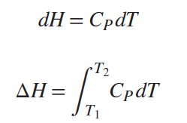
Sensible Heat Effects
Again, the final term is zero for two situations:
For any constant-pressure process.
When the enthalpy is independent of pressure, regardless of process. This is exactly true for the ideal-gas state and approximately true for real gases at low pressure and high temperature.
In either case

Slide 13

Sensible Heat Effects
Moreover, Q = ΔH for mechanically reversible, constant-pressure, closed-system processes and for the transfer of heat in steady-flow processes where ΔE_{P} and ΔE_{K} are negligible and W_{s} = 0
In either case,
This equation finds frequent application for flow processes designed for simple heating and cooling of gases, liquids, and solids.

Slide 14


Temperature Dependence of the Heat Capacity
Evaluation of the integral in above equation requires knowledge of the temperature dependence of the heat capacity. This is usually given by an empirical equation; the two simplest expressions of practical value are:
where α, β, and γ and a, b, and c are constants characteristic of the particular substance. With the exception of the last term, these equations are of the same form.

Slide 15

Temperature Dependence of the Heat Capacity
We therefore combine them to provide a single expression:
where either C or D is usually zero, depending on the substance considered.
Because the ratio C_{P}/R is dimensionless, the units of C_{P} are governed by the choice of R.

Slide 16
Hypothetical Ideal gas state
As P → 0 a gas approaches the ideal-gas state, where molecular volumes and intermolecular forces are negligible.
Accordingly, ideal-gas-state heat capacities, designated by C_{P}^{ig} and C_{V}^{ig}, are functions of temperature, but independent of pressure.
The ideal gas heat capacity rather than the actual heat capacity is used in the evaluation of thermodynamic properties such as enthalpy.

Slide 17

Temperature Dependence of the Heat Capacity
The two ideal-gas-state heat capacities are related as:

Slide 18
Latent Heat Of Pure Substances
When a pure substance is liquefied from the solid state or vaporized from the liquid at constant pressure, no change in temperature occurs; however, the process requires the transfer of a finite amount of heat to the substance.
These heat effects are called the latent heat of fusion and the latent heat of vaporization.
Latent heat of fusion: The amount of heat required to melt the substance of unit mass from solid to liquid.
Latent heat of vaporization: The amount of heat required by the unit mass of substance to vaporize from liquid to gaseous state
Notes:
latent heat of fusion amount of heat required to melt the substance of unit mass from solid to liquid
latent heat of vaporization The amount of heat required by the unit mass of substance to vaporize from liquid to gaseous state

Slide 19
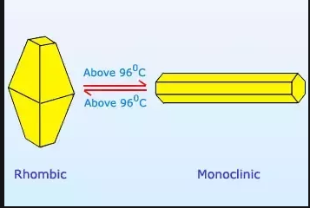
Heat of Transition (or heat of transformation)
The amount of heat that must be absorbed or given up by a substance when it undergoes an equilibrium constant-pressure and constant-temperature transition from one phase to another.
For example, the heat absorbed when rhombic crystalline sulfur changes to the monoclinic structure at 368.15 K (95°C) and 1 bar is 360 J for each g atom.
Notes:
latent heat of fusion amount of heat required to melt the substance of unit mass from solid to liquid
latent heat of vaporization The amount of heat required by the unit mass of substance to vaporize from liquid to gaseous state

Slide 20
The characteristic feature of all these processes is the coexistence of two phases.
According to the phase rule, a two-phase system consisting of a single species is univariant, and its intensive state is determined by the specification of just one intensive property.

Slide 21

Thus the latent heat accompanying a phase change is a function of temperature only, and is related to other system properties by an exact thermodynamic equation:
ΔH= Latent Heat
ΔV= Volume change accompanying the phase change
P^{sat} = saturation pressure

Slide 22
Standard Heat Of Reaction
Heat of Reaction ΔH (also known and Enthalpy of Reaction) is the change in the enthalpy of a chemical reaction that occurs at a constant pressure.
It is a thermodynamic unit of measurement useful for calculating the amount of energy per mole either released or produced in a reaction.
Since enthalpy is derived from pressure, volume, and internal energy, all of which are state functions, enthalpy is also a state function.

Slide 23
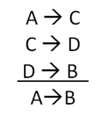
Standard Heat Of Reaction
Since enthalpy is a state function, the heat of reaction depends only on the final and initial states, not on the path that the reaction takes.
For example, the reaction A→B goes through intermediate steps (i.e. C→D ), but A and B remain intact.

Slide 24
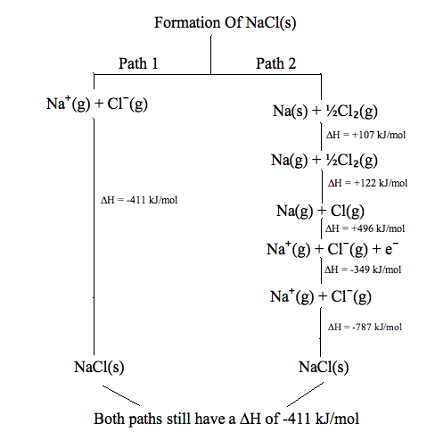
Two different paths from same initial and final states results in the state variables values

Slide 25
Standard Heat Of Reaction
The standard enthalpy of reaction is symbolized by ΔH° or ΔH°_{rxn} and can take on both positive and negative values. The units for ΔH° are kilo Joules per mole, or kJ/mol.
Δ = represents the change in the enthalpy
Since the ΔH° represents the total energy exchange in the reaction this value can be either positive or negative.
A positive ΔH° value represents an addition of energy from the surroundings, resulting in an endothermic reaction.
A negative value for ΔH° represents a removal of energy into the surroundings and so the reaction is exothermic.
° = signifies that the reaction is a standard enthalpy change, and occurs at a pre-set pressure/temperature
_{rxn} = denotes that this change is the enthalpy of reaction
Notes:
The Standard State: The standard state of a solid or liquid is the pure substance at a pressure of 1 bar and at a relevant temperature.

Slide 26
Standard Heat Of Reaction
Chemical reactions also are accompanied either by the transfer of heat or by temperature changes during the course of reaction-in some cases by both.
For example, the reactants in a combustion reaction possess greater energy than products, and this energy must either be transferred to the surroundings as heat or produce products at an elevated temperature.
Notes:
Combustion reactions occur when oxygen reacts with another substance and gives off heat and light. Burning coal, methane gas, and sparklers are all common examples of combustion reactions. Essentially, any reaction that involves burning something is a combustion reaction.

Slide 27
Standard Heat Of Reaction
Flow-calorimeter method
Fuel gas is mixed with air at a temperature T, and the mixture flows into a combustion chamber where reaction occurs.
The combustion products enter a water-jacketed section in which they are cooled to temperature T.
Because no shaft work is produced and the calorimeter is designed to eliminate potential- and kinetic-energy changes, the energy balance equation for steady state steady flow process for single entrance and exit reduces to
Q = ΔH
Notes:
Fuel gas: The gases that may be burned to produce thermal energy, including natural gas, propane, butane, liquefied natural gas (LNG) or hydrogen.

Slide 28
Standard Heat Of Reaction
Thus the enthalpy change caused by the combustion reaction is equal in magnitude to the heat flowing from the reaction products to the water, and may be calculated from the temperature rise and flow rate of the water.
It is the universal practice is to designate the enthalpy change of reaction ΔH as the heat of reaction.
For example,
aA + bB lL + mM

Slide 29
Standard Heat Of Reaction
Standard heat of reaction is defined as
“The enthalpy change when a moles of A and b moles of B in their standard states at temperature T react to form l moles of L and m moles of M in their standard states at the same temperature T.”
A standard state is a particular state of a species at temperature T and at specified conditions of pressure, composition, and physical condition as, e.g., gas, liquid, or solid.

Slide 30
Standard Heat Of Reaction
The standard states are
Gases: The pure substance in the ideal-gas state at 1 bar.
Liquids and solids: The real pure liquid or solid at 1 bar.
Property values in the standard state are denoted by the degree symbol. For example, Cp˚; is the standard-state heat capacity.

Slide 31
Standard Heat Of Reaction
All conditions for a standard state are fixed except temperature, which is always the temperature of the system. Standard-state properties are therefore functions of temperature only.
When a heat of reaction is given for a particular reaction, it applies for the stoichiometric coefficients as written.
If each stoichiometric coefficient is doubled, the heat of reaction is doubled. For example, the ammonia synthesis reaction may be written:

Slide 32
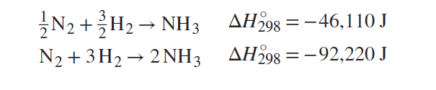
Standard Heat Of Reaction
The symbol ΔH˚₂₉₈ indicates that the heat of reaction is the standard value for a temperature of 298.15 K (25°C).

Slide 33

Standard Heat of Formation
A formation reaction is defined as a reaction that forms a single compound from its constituent elements. For example, the reaction is a formation reaction for methanol.
The reaction H₂O + SO₃ → H₂SO₄ is not a formation reaction, because it forms sulfuric acid not from the elements but from other compounds.

Slide 34
Standard Heat of Formation
Standard heat of formation is the enthalpy change associated with the formation of one mole of a compound from its elements in their standard states.
The standard conditions for thermochemistry are 25°C and 1 bar.
Therefore, the standard state of an element is its state at 25°C and 1 bar.
For example, iron is a solid, bromine is a liquid, and oxygen is a gas under those conditions.

Slide 35
Standard Heat of Formation
The standard heat of formation of an element in its standard state is by definition equal to zero.
The for the diatomic elements, H₂ (g), N₂ (g), O₂ (g), F₂ (g), Cl₂ (g), Br₂ (l), and I₂ (g).

Slide 36
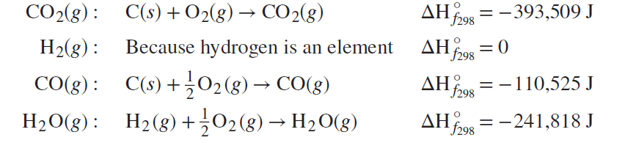
Standard Heat of Formation
The water-gas-shift reaction,
CO₂(g) + H₂(g)→ CO(g) + H₂O(g) at 25°C,
is commonly encountered in the chemical industry.

Slide 37
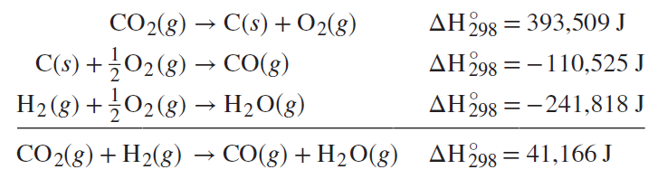
Standard Heat of Formation
Writing the formation reactions so that their sum yields the desired reaction requires that the formation reaction for CO₂ be written in reverse; the heat of reaction is then of opposite sign to its standard heat of formation:

Slide 38
Standard Heat of Combustion
A combustion reaction is defined as a reaction of an element or compound with oxygen to form specified combustion products.
For organic compounds consisting only of carbon, hydrogen, and oxygen, the products are carbon dioxide and water, but the state of the water may be either vapor or liquid.

Slide 39
Standard Heat of Combustion
Standard Heat of Combustion is defined as the enthalpy change when one mole of a substance undergoes complete combustion, with excess of oxygen at standard conditions (25°C and 1 bar).
nX + mO₂ → xCO₂ (g) + yH₂O (l) + heat of combustion
where n, m, x, y and z are the number of moles of each molecule in the balanced equation.

Slide 40

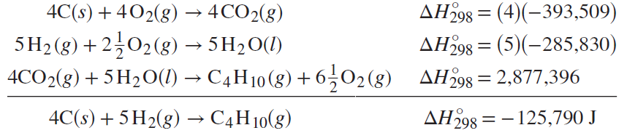
Standard Heat of Combustion
A reaction such as the formation of n-butane:
Above reaction is not feasible in practice. However, this equation results from combination of the following combustion reactions:

